Slide 1
Introduction to Provider-hosted Add-ins
Speaker name

Slide 2
Introduction to Provider-hosted Add-ins

Slide 3
Agenda
Introduction
Programming in C#
Remote event receivers
Remote “jobs” and provisioning

Slide 4
Developer vision

Slide 5
1
Introduction

Slide 6
Cloud architecture
SQL Azure
Azure websites
aspx
png
js
Azure Data Market
C#
CSS
master
SharePoint Online
App web
Host web

Slide 7
On-premises architecture
Databases
Internet information server
aspx
png
js
Web services
C#
CSS
master
SharePoint 2013
App web
Host web

Slide 8
Remote web always has full rights to Add-in web
Add-in permissions are the lesser of user and Add-in permissions to the given resource
Provider-hosted Add-ins can utilize “app-only” permissions to “elevate” privileges
Add-in permissions

Slide 9
Considers Add-in permissions only, ignores user
Set AllowAppOnlyPolicy to true in add-in manifest
Get an app-only token
App-only permissions
Notes:
Provider-hosted apps can use “app only” permissions
Update the App manifest to indicate this is OK
Then you need an app-only token in code

Slide 10
Web project
ASP.NET web forms
MVC 5
Authorization
Azure access control services
Server-to-server high trust
Programmability
SharePointContextProvider class
Managed CSOM or REST
JavaScript cross-domain library
Creating Provider-hosted Add-ins
Notes:
Visual Studio supports both ASP.NET Web Forms and MVC5
On-premises authorization uses S2S
Cloud authorization uses OAuth
The SharePointContextProvider simplifies token management
Managed CSOm and RESt can be used directly from the server side
The cross-domain library can be used from JavaScript

Slide 11
Demo
1 Introduction
Creating a provider-hosted app
Notes:
Create a basic provider hosted app

Slide 12
2
Programming in C#

Slide 13
Checks for valid Context Token
Redirects if it does not exist
Simplifies the management of context
Provides an ACS or STS context
Context exposes properties for key values like Host Web URL
Simplifies the management of tokens
Context exposes methods to retrieve tokens
SharePoint
Context Provider Class
Notes:
The SharePointContextProvider simplifies the management of context, and tokens
It uses a cookie to store the CacheKey, and stores the actual token in session state on the server referenced by the cache key
All of this improves performance and makes programming easier

Slide 14
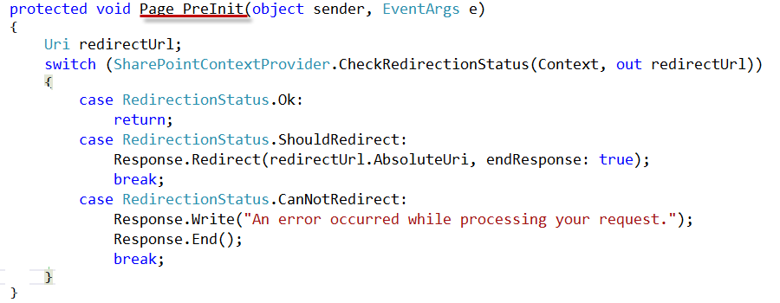
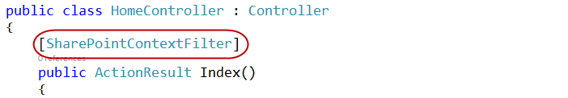
Validating Context Token
Web forms
MVC 5
Notes:
ASP.NET Web Forms uses the PreInit method to validate the Context Token
Notice how it will redirect if the token is not valid
ASP.NET MVC 5 uses a filter to run essentially the same code
Notice how the filter attribute is applied to the controller

Slide 15
SharePointContextProvider GetSharePointContext
Returns SharePointAcsContext in cloud
Returns SharePointHighTrustContext on premises
Properties
SPAppWebUrl
SPClientTag
SPHostUrl
SPLanguage
SPProductNumber
Managing SharePoint Context
Notes:
SharePointAcsContext and SharePointHightTrustContext both inherit from SharePointContext
This means that the same code works in both cloud and on-premises environments

Slide 16
CSOM
CreateAppOnlyClientContextForSPAppWeb
CreateAppOnlyClientContextForSPHost
CreateUserClientContextForSPAppWeb
CreateUserClientContextForSPHost
REST
AppOnlyAccessTokenForSPAppWeb
AppOnlyAccessTokenForSPHost
UserAccessTokenForSPAppWeb
UserAccessTokenForSPHost
Managing Security Tokens
Notes:
The SharePointContext makes it easy to get the tokens you need

Slide 17
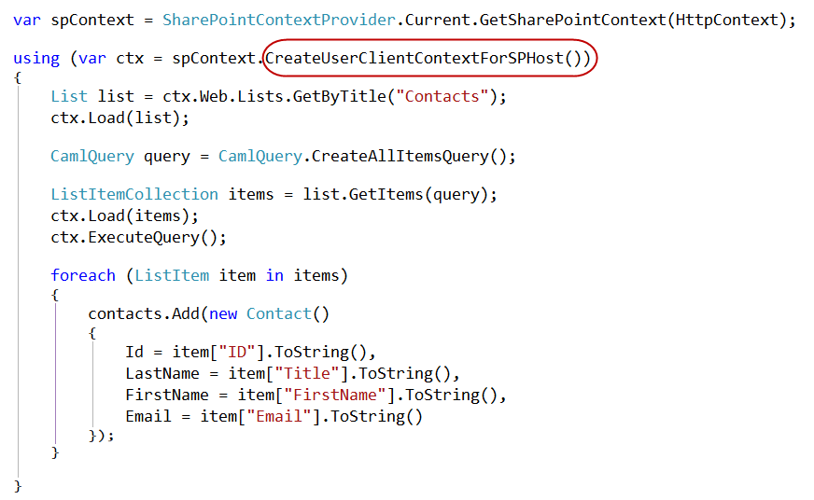
Managed CSOM

Slide 18
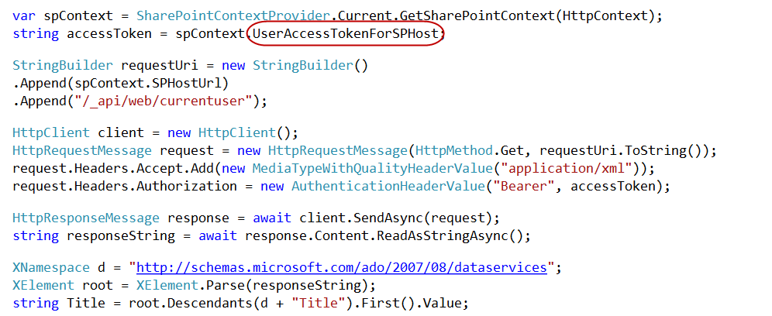
Managed REST

Slide 19
3
Remote event receivers

Slide 20
Event Handler code runs in remote web
Deployed as web service in remote web
Two-way events
“Before” events (aka, “ING” events)
Synchronous call
Supports a return value
One-way events
“After” events (aka, “ED” events)
Asynchronous call
No return value
Remote event handlers
Notes:
The event handler infrastructure follows the same pattern as the in-process handlers of old
We have both “before” and “after” event
These are also known as “ING” and “ED” events like “ItemAdding” and “ItemAdded”
Two-way events are synchronous

Slide 21
Supported events
 | SITE | LIST | LIST SCHEMA | LIST ITEM | APP
Create | X | X | X | X
Update |  |  | X | X
Delete | X | X | X | X
Move | X |  |  | X
Check-in |  |  |  | X
Uncheck-in |  |  |  | X
Check-out |  |  |  | X
Attachments |  |  |  | X
File move/convert |  |  |  | X
Install |  |  |  |  | X
Uninstall |  |  |  |  | X
Update |  |  |  |  | X

Slide 22
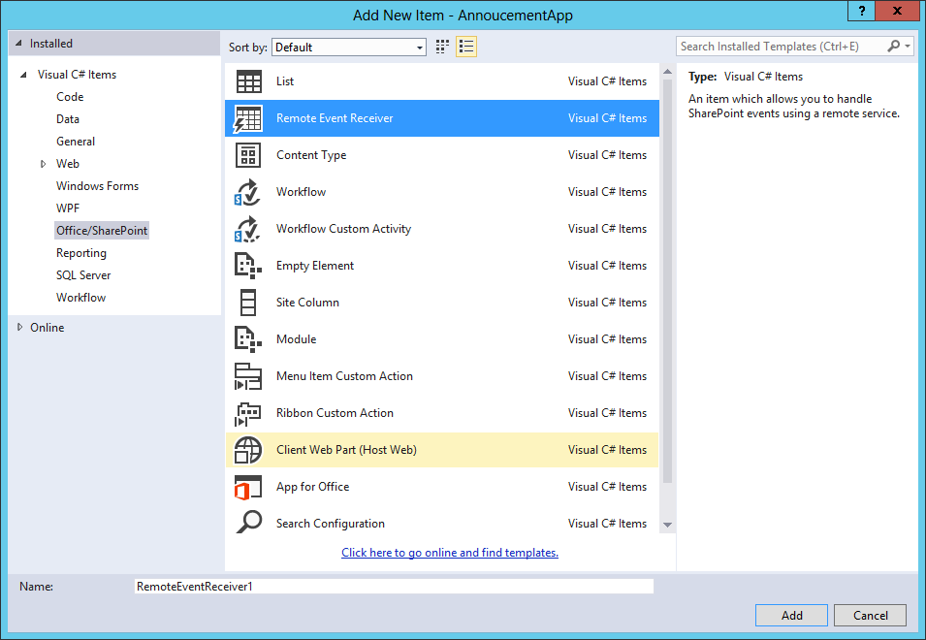
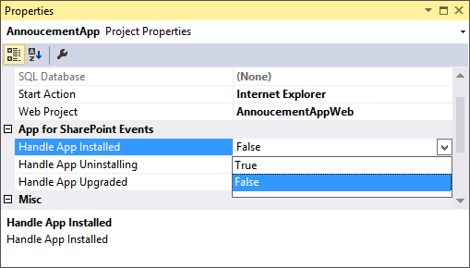
Use the “Add New” dialog
For Site, List, Item, and Schema events
Adding a remote event receiver
Use the “Properties” dialog for App events

Slide 23
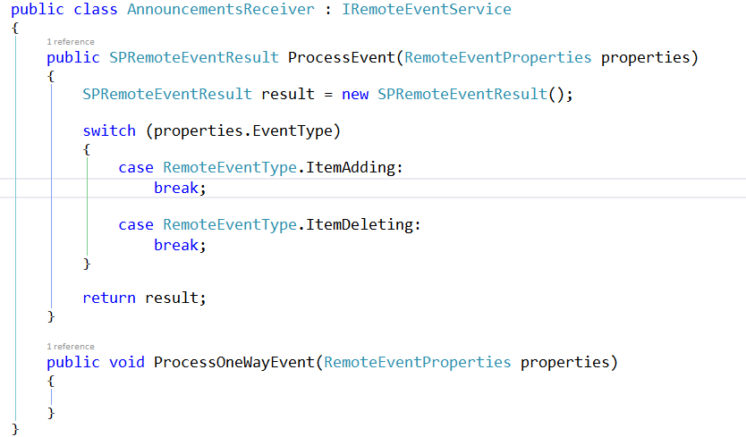
IRemoteEventService
Must be implemented by the remote web service

Slide 24
Passed to web service in response to event
Provides contextual information
Supports reading and updating user inputs
Allows for data validation
SPRemoteEvent Properties

Slide 25
SPRemoteEvent Result
Returns by two-way events
Allows events to be cancelled
Allows status to be returned

Slide 26
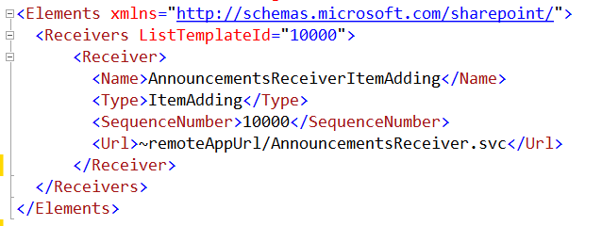
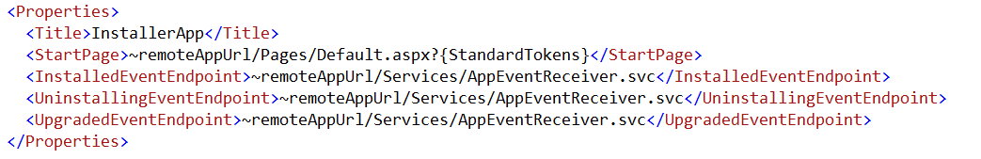
Registering events receivers
CAML element for lists, items, sites, and schema events
App manifest for app events

Slide 27
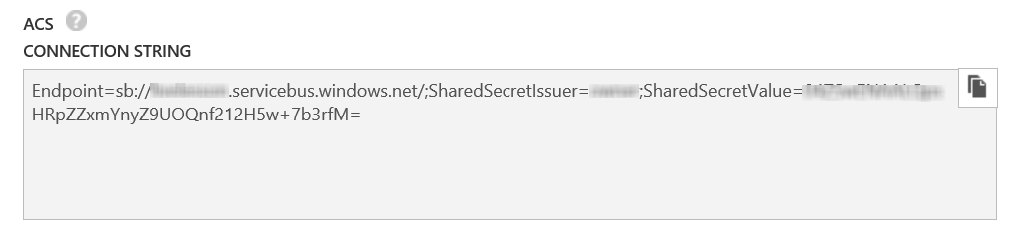
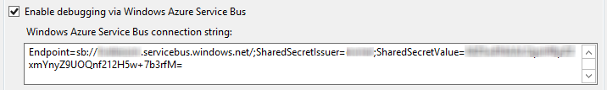
Debugging considerations
Remote event receivers might require Azure Service Bus to support debugging
Create a Service Bus Namespace
Copy the Connection String into the SharePoint Project Properties
Notes:
Note that as of this writing, the Visual tooling only supports ACS strings
The Azure interface only creates SAS strings
So, you have to use PowerShell
Download and Install Azure PowerShell environment
Open PS window
Add-AzureAccount to sign in
New-AzureSBNamespace –Name “myns” -Location “Central US”
Results in an ACS string copy this to Visual Studio

Slide 28
Demo
3 Remote event receivers
Remote event receivers

Slide 29
4
Remote “jobs” and provisioning

Slide 30
Remote “jobs” authentication
SharePointOnlineCredentials
Run with a service account that will operate with permissions of the account
char[] pwdChars = ConfigurationManager.AppSettings["AccountPassword"].ToCharArray(); System.Security.SecureString pwd = new System.Security.SecureString(); for (int i = 0; i < pwdChars.Length; i++) pwd.AppendChar(pwdChars[i]); ClientContext cc = new ClientContext(siteUri); cc.AuthenticationMode = ClientAuthenticationMode.Default; cc.Credentials = new SharePointOnlineCredentials(ConfigurationManager.AppSettings["AccountUsername"], pwd);
ClientContext
Runs with the permissions defined in the app permissions
//Get the realm for the URL string realm = TokenHelper.GetRealmFromTargetUrl(siteUri); //Get the access token for the URL. Requires this app to be registered with the tenant string accessToken = TokenHelper.GetAppOnlyAccessToken(TokenHelper.SharePointPrincipal, siteUri.Authority, realm).AccessToken; //Get client context with access token using (var clientContext = TokenHelper.GetClientContextWithAccessToken(siteUri.ToString(), accessToken)) {

Slide 31
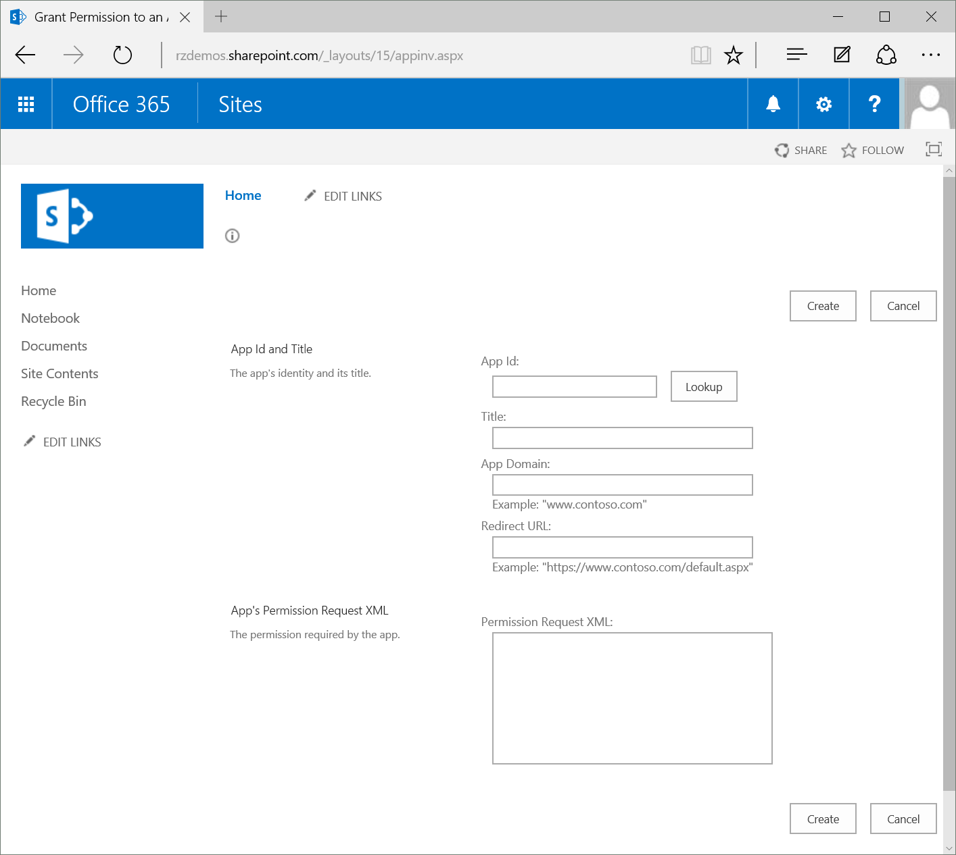
Remote “jobs” authentication
AppInv.aspx
Used to grant permissions to an application without a User Interface
Application must first be registered via AppRegNew.aspx
Copy Permissions block from manifest into “App’s Permission Request XML” field

Slide 32

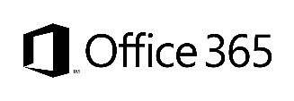
Provisioning options/comparison
Options
Site definition
No Office 365
Long term impact on costs
Blocks transition to cloud
Causes significant issues with future migration and upgrade
Site templates
Poor site collection creation story
Negative impact on upgrades
Causes additional maintenance costs with service updates
Not with publishing features
Web templates
Poor site collection creation story
Causes maintenance costs with service updates
SP server-side provisioning
Provision OOB sites, but modify them based on user selection and requirements
Standardization of site creation in code
No Office 365
Remote provisioning
CSOM supports creation of site collections for on premises and cloud
Standardization of site creation in code
Can be done from any external system
Support in cloud
Options available
Good
Fair
Average
Good
Excellent
Cost impact (short and long term)
Notes:
Vesa
For more information on provisioning sites and associated terminology see:
SharePoint 2010 and web templates, http://blogs.msdn.com/b/vesku/archive/2010/10/14/sharepoint-2010-and-web-templates.aspx
Site provisioning techniques and remote provisioning in SharePoint 2013, http://blogs.msdn.com/b/vesku/archive/2013/08/23/site-provisioning-techniques-and-remote-provisioning-in-sharepoint-2013.aspx

Slide 33
What
Provision new site collections from add-in side
Why
Can be used to override out-of-the-box self-service site collection creation form
Can be used to integrate additional functionalities as part of the provisioning
How
Office 365 has separate downloadable that includes the needed CSOM elements to provision sites
After 2014 April CU, natively supported for on premises as well
Site collection creation from add-ins
Notes:
Vesa

Slide 34
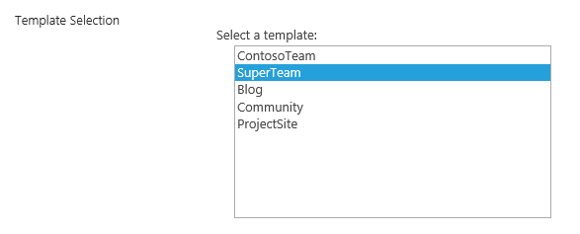
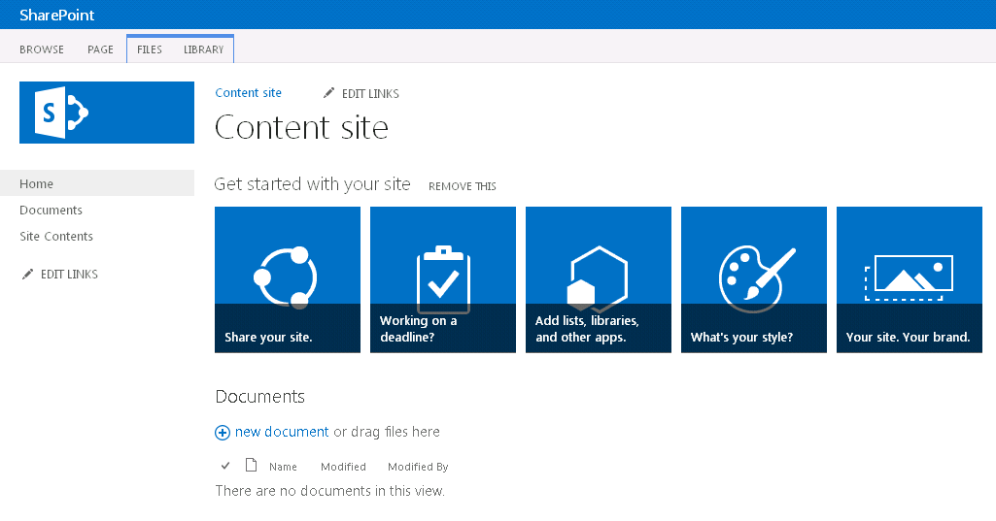
Async provisioning model
1
Provider-hosted add-ins
2
3
6
4
https://contoso.sharepoint.com /sites/site
Remote timer job
5
C#
Notes:
Vesa

Slide 35
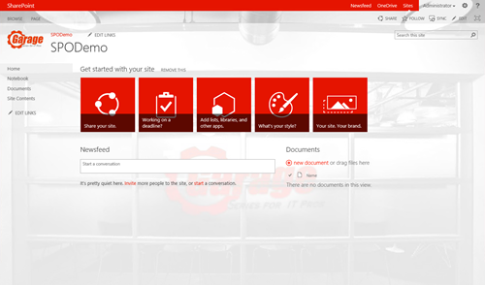
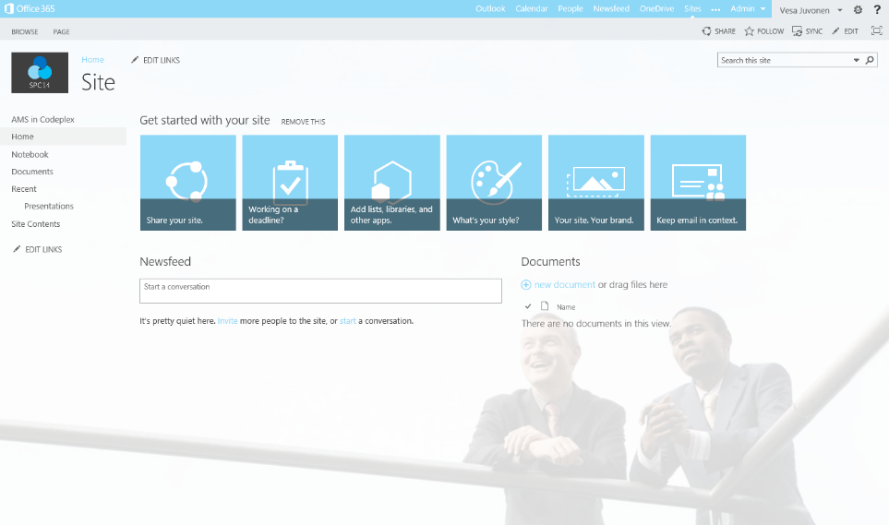
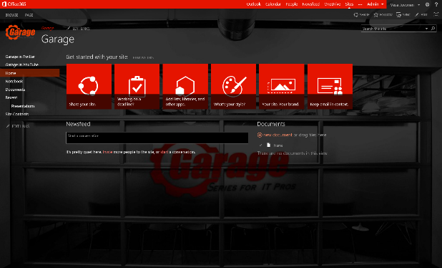
Provisioning time logic
3
Project site
1
2
Remote timer job
3
Organizational
Assets and configuration
Branding images
Master pages
Page layouts
Other settings
Initial provisioning based on the out of the box site. Usually either team site or publishing site. Assets are uploaded from the provisioning engine using CSOM/REST
3
Workgroup
Apply the needed changes (configurations etc.) on top of the out of the box site based on the user selection. This is the specialization part, but since we start from OOB site, we always get the latest improvements to it as a base line.
Notes:
Vesa

Slide 36
Demo
4 Remote “jobs” and provisioning
Remote “jobs” and provisioning

Slide 37
Summary
Introduction
Programming in C#
Remote event receivers
Remote “jobs” and provisioning

Slide 38
Further reading…
SharePoint Code Samples
SharePoint Training videos and hands on labs
SharePoint documentation
Transforming SharePoint customizations to add-in model

Slide 39
Developer Program launch
1 YEAR FREE
Email Newsletters
Free Developer Subscription
Free Training
Free Tools
Webinars
http://dev.office.com/devprogram

Slide 40
Engage

